Slide 1
J.K.P.PG COLLEGE MZN
DRG & PTG DEPARTMENT
Teacher - Archna

Slide 2
BENGAL SCHOOL
Wash Painting Artist

Slide 3
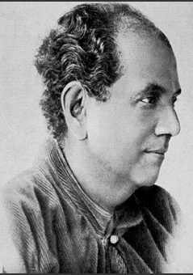
Abanindranath Tagore
1871-1951

Slide 4
Abanindranath Tagore
Born – 7 August 1871 Jorasanko, Kolkata
Died - 5 December 1951, Kolkata
Bengal School Artist
Know for – Painting, Writing
Book – Six limbs of indian painting

Slide 5
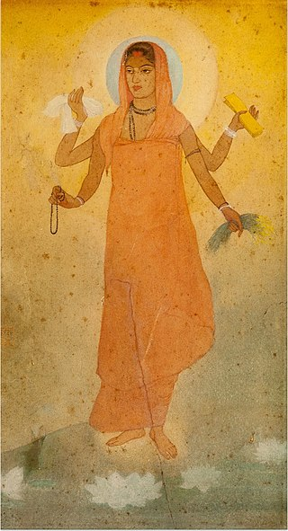
Bharat Mata
Wash

Slide 6
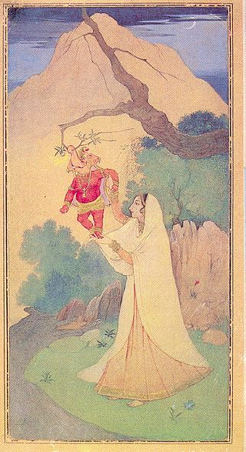
Ganesh-Janani
Wash

Slide 7
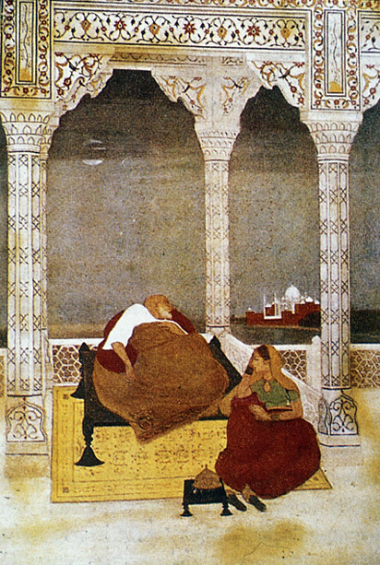
The Passing of Shah Jahan
1900

Slide 8
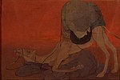
Journey’s End
1913

